Slide 1
The Dealhound ™
A smart consumer’s best friend
Ventura High School
Mekalyn Steve
Jack Sartee
Jonathan Dominguez

Slide 2
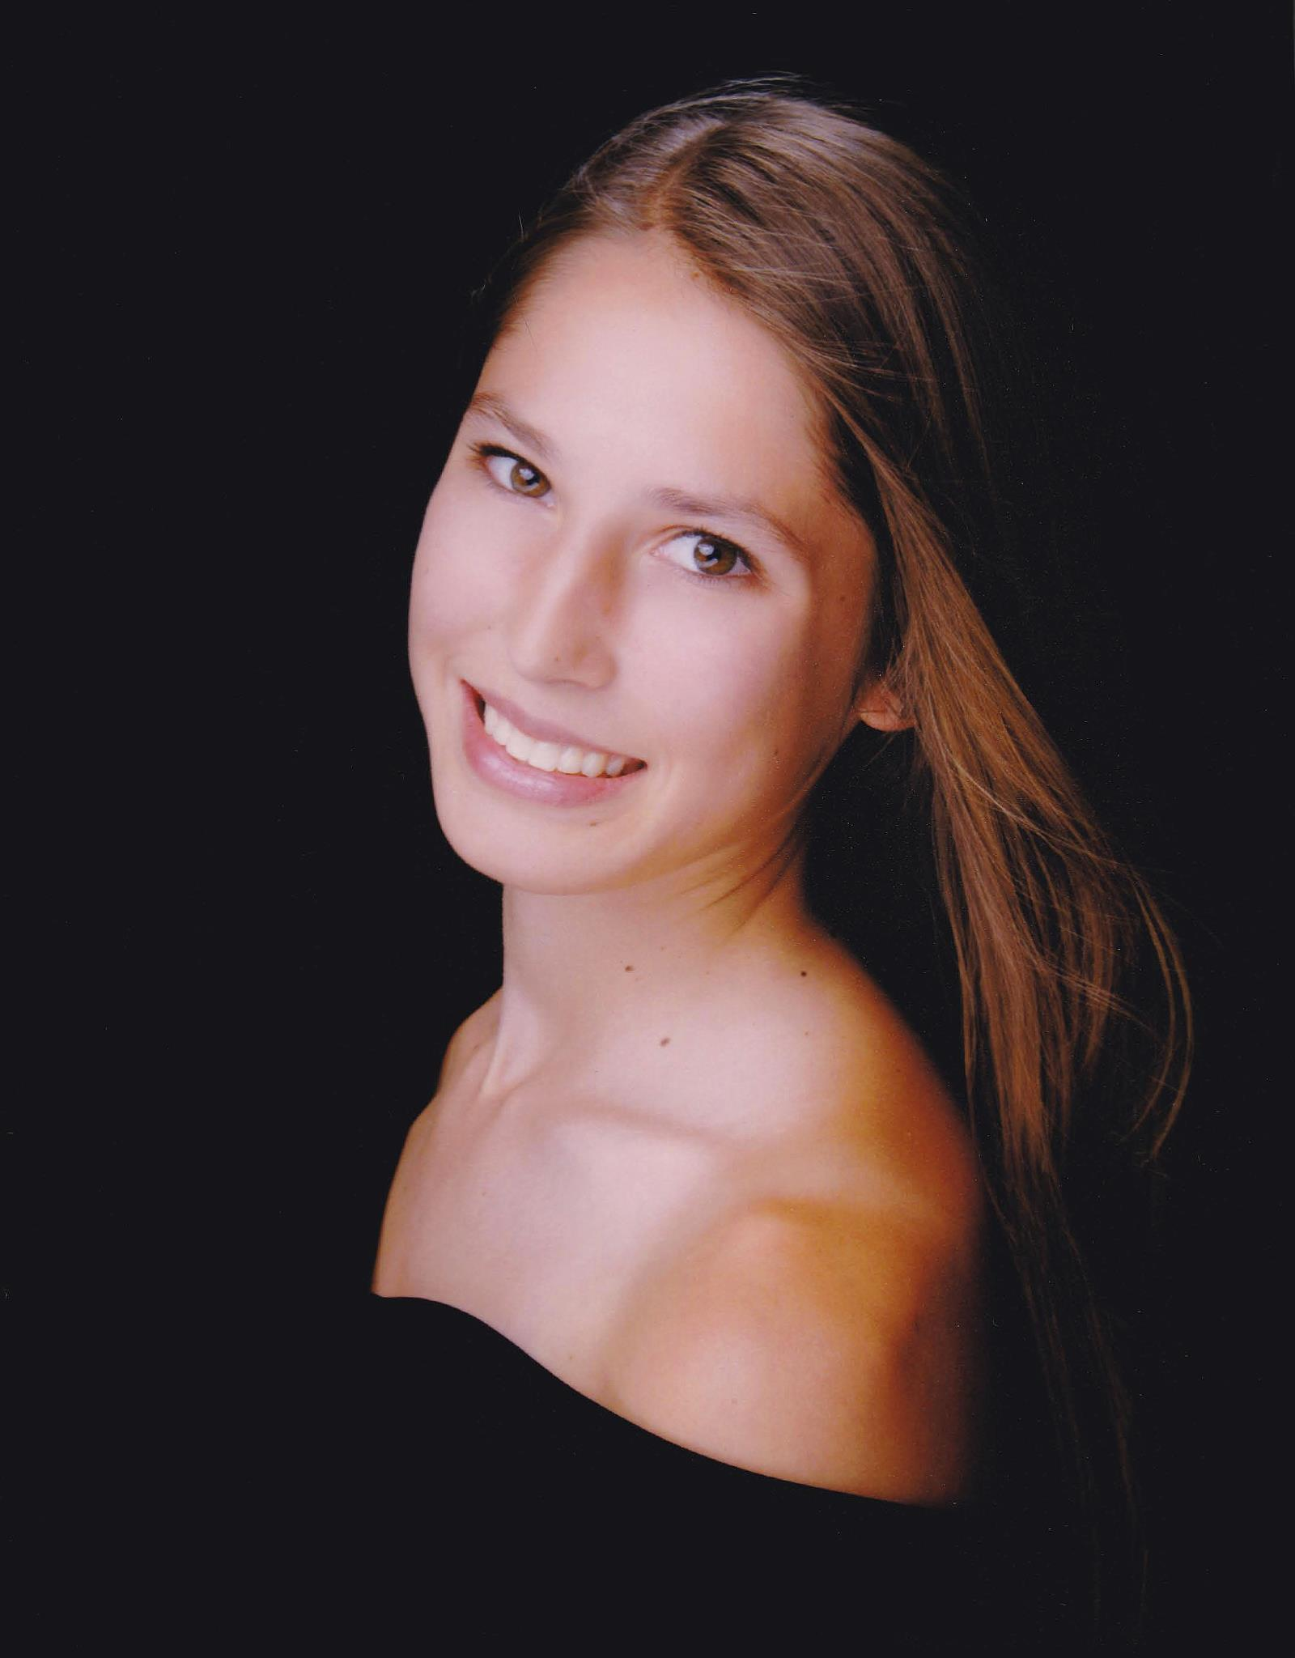
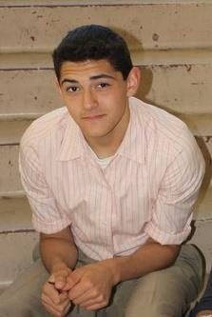
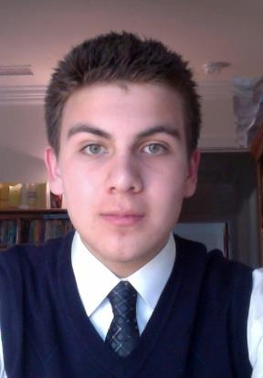
The dealhound™ Team
Mekalyn Steve – Design expert and marketer
Writes for the Ventura Star.
Future: UCSB with a major in communications.
Jack Sartee – Business mastermind
Employment at Ventura Boat Rentals.
Future: Full-ride NROTC Marine Officer scholarship with a major in Political Science.
Jonathan Dominguez – Programmer, presenter
7 years of programming experience with proficiency in Java, C, C++, Objective-C, HTML, PHP, MySQL and Python.
Self-employed as a website designer and developer.
Interned for 6 months on a congressional campaign with a focus on networking.
Future: NYU with a double major in Computer Science and Mathematics.

Slide 3
Problem
Consumers want/need to save money.
Businesses need more traffic.
Current method is ineffective and inefficient.
What if there was a quick and easy way to solve these problems?
74% of consumers search multiple coupon sources each week.
Notes:
60% on average spend two hours or more a week looking for coupons.
31% spend 3 hours per week looking for online deal.

Slide 4
Market Analysis
78% of consumers have used a coupon in the past year.
263% increase in online coupon usage.
$458 billion in coupons distributed yearly.
Large and expanding market.
Consumers received $4.6 billion in coupon savings in 2011.
Notes:
Healthy growth

Slide 5
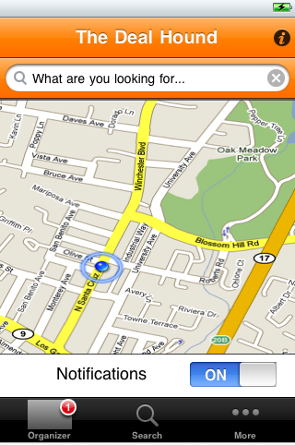
Solution – The dealhound™
Focused, efficient, effective, and cheap advertising for businesses.
Deals, coupons, and sales when and where you need them.
42% percent of smartphone users have used a mobile coupon.
Notes:
With The Dealhound we can focus your advertising towards those who are likely to buy your product or use your service and users will be able to save their coupons and take advantage of sales when they are likely to spend.

Slide 6
Features
Coupon Organizer
A simple solution to the users problem.
Innovative
On the Go
A simple solution to the companies’ problem.
An effective way to grow the user base.
Hands free.
User Uploaded Content
Digital coupon usage increased 11% in the last year.
Notes:
Users can scan, save and be notified of coupons. It’ll be an efficient solution to the problem of un-redeemed coupons.
Coupons that are scanned and saved will be added to a database where they can be searched for and found by other users.
Siri and GPS integration. You select what you are looking for and as you’re on the go the app will notify of coupons and deals.

Slide 7
What sets us apart
Free for users.
User-upload content.
Hands free and easy to use.
Targeted advertising.
Consumers are 23% more likely to use a mobile coupon than a daily deal from Groupon or Living Social.
Notes:
Groupon and Living Social
Users will advertise and do the work for you
Consumers are 23% more likely to use a mobile coupon than a daily deal from Groupon or Living Social.
Siri and GPS integration.
You only reach people who are looking for your product or service, you pay per notification.

Slide 8
Monetization
Profits generated from companies.
Most effective and efficient way to generate traffic and business.
78.3% of consumers have used a coupon in the last year.
Notes:
We’re gonna make our money off of companies and businesses paying to be featured on the On the Go function.
You only reach people who are looking for your product or service, you pay per notification.
We project slow and steady growth for the first 3 years as we develop, advertise, and expand and eventually we’ll reach exponential growth as the market and user base expands exponentially.
78.3% of consumers have used a coupon in the last year.

Slide 9
3 Year Business plan
Grow User Base
Expand
App Development
App Development
Hire designer
Code app
Test the app
Grow User Base
Advertising
User-uploaded content/social media
Expand
Partner with companies and business.
There was a 47% increase in use of local coupons in 2011.
Notes:
Start with companies and business (Camarillo Outlets and Pacific Mall) in Ventura County and eventually expand to all of California, and then all of the U.S.
There was a 47% increase in use of local coupons in 2011.

Slide 10
Investment plan and why should you invest in us?
$120,000 initial investment.
Amazing potential for growth and capital return.
We have all the experience and talent needed to launch this app.
Mobile coupons are redeemed 10 times as often as traditional coupons.
Notes:
We’re attempting to break into a multi billion dollar market that is rapidly expanding by the day.
We’re combining the best aspects of our competitors along with our own inventions and designs to make a truly innovative product.
There is potential for major growth and profits.
Our needs are small because most of the work will be in-house and we have all the talent and experience needed to launch this app so its not a matter of how but when.
Mobile coupons are redeemed 10 times as often as traditional coupons.

