Slide 1
Pedatronic pəˈdɑːtränik
Kyndle Macnaughton
Michael Martinez
Taylor Barnes

Slide 2
Problem
Child obesity increasing
Ventura County problem
Electronics usage

Slide 3
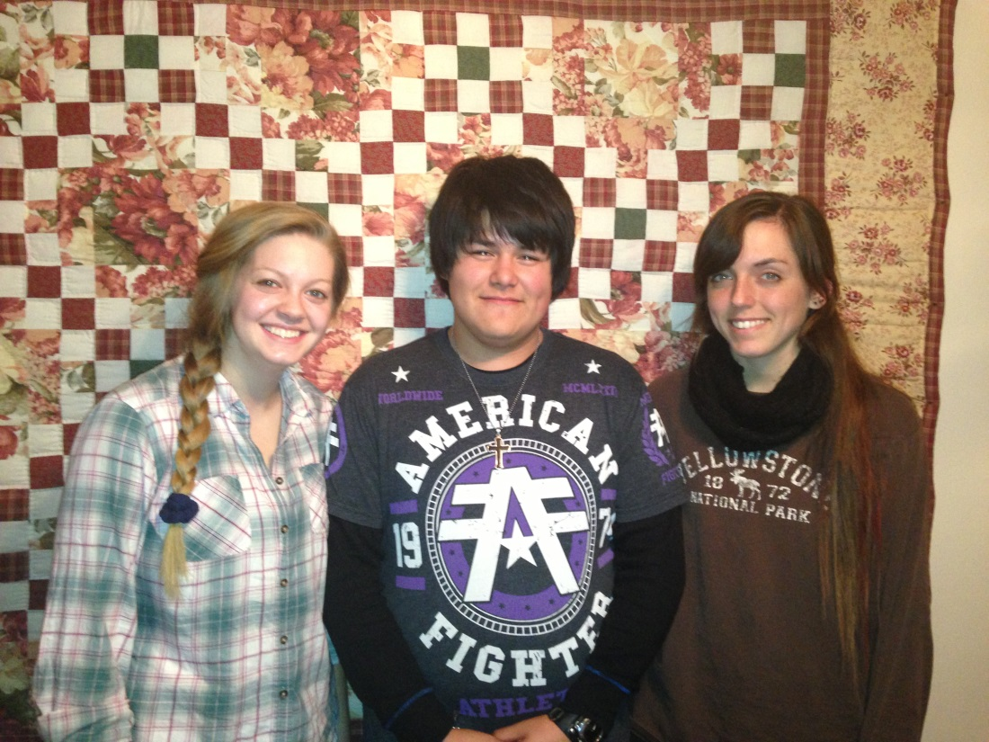
Our Team
GO BULLDOGS!
Michael Martinez
Photography
Two little brothers
Kyndle Macnaughton
Marine Biology
Two nephews, one niece
Taylor Barnes
Pediatric surgeon
Two nephews, one niece

Slide 4
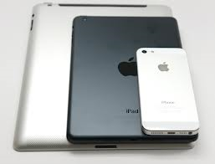
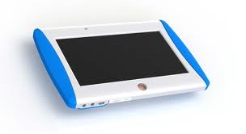
Solution
Flip the problem
Electronic motivation

Slide 5
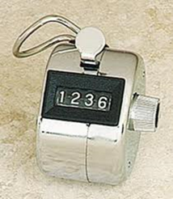
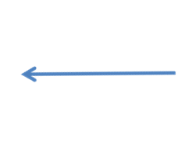
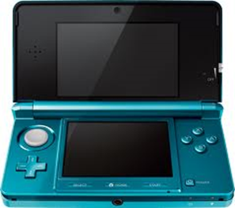
How Does It Work?

Slide 6
Target Market
Primary target market
Parents of children
67% of households
Drive demand
Children
73 million

Slide 7
Competition
 | Striiv | Ibitz | Geopalz | Pedatronic
Child-use specific |  | √ | √ | √
Incentive | Competition | Keep pet alive | Earn points | Electronic usage
Price | $52-$99 | $35 | $25 | $35
Ease of Use | Low battery life | Difficult to attach | Breaks easily | √
Marketed for function | √ |  |  | √
Links to App | Free | Free | Free | Free

Slide 8
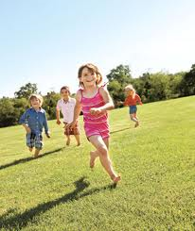
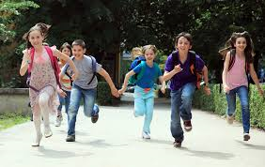
Monetization
Retail price: $35
Cost: $15
App/website: free
Marketing
Summerfest
YMCA Fun and Fitness 5k
Sporting goods stores
Game stores
Cellular phone stores

Slide 9
Next Few Years
First 6 Months
Hire coder
Develop prototype
6-18 Months
Initial run of product
Hire engineering consultant
18 Months- 3 Years
Hire sales force
Second run of product
Apply for patent
Engage design firm
Start test marketing
Secure domain name
Design modifications
Market to potential partners
Commercialization

Slide 10
Investment- 18 months

